Slide 1

Kishkinda. university
Bellary.

Slide 2

Athlete sponsorship manager.
Presented by:
Sl.no Name usn.
1. shivakumar b v kub23cse133
2. maritemappaa s k kub23cse081
3. prajwal b kub23cse104
4. Basavaraj k s kub23cse023
5. Prasanna b kub23cse105

Slide 3


Athlete sponsorship manager.
Presented by:
sl.n0 Name usn
1. shivakumar b v kub23cse133
2. maritemappaa s k kub23cse081
3. prajwal b kub23cse104
4. Basavaraj k s kub23cse023
5. Prasanna b kub23cse105

Slide 5


Slide 6


Slide 7


Slide 8
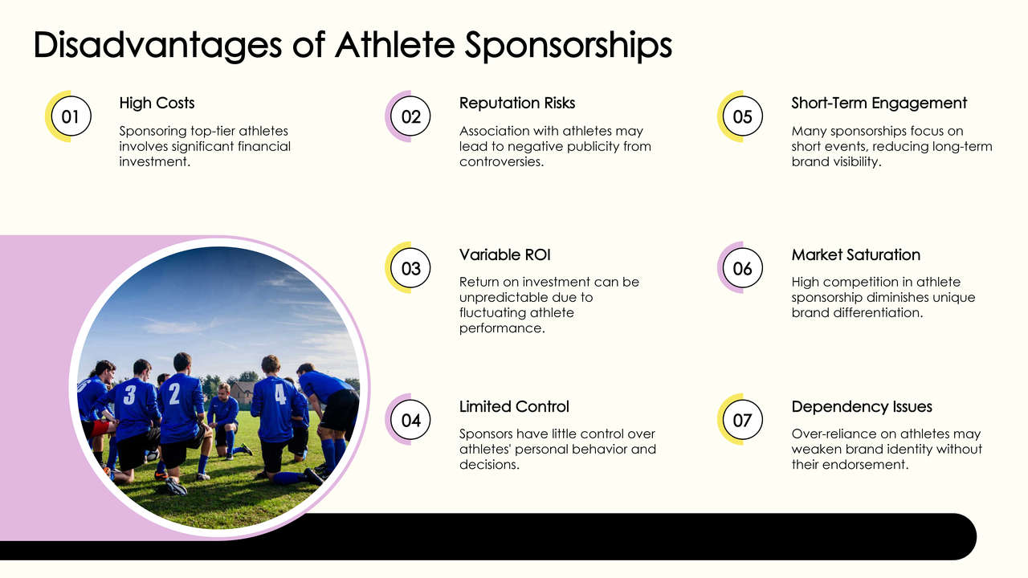

Slide 9
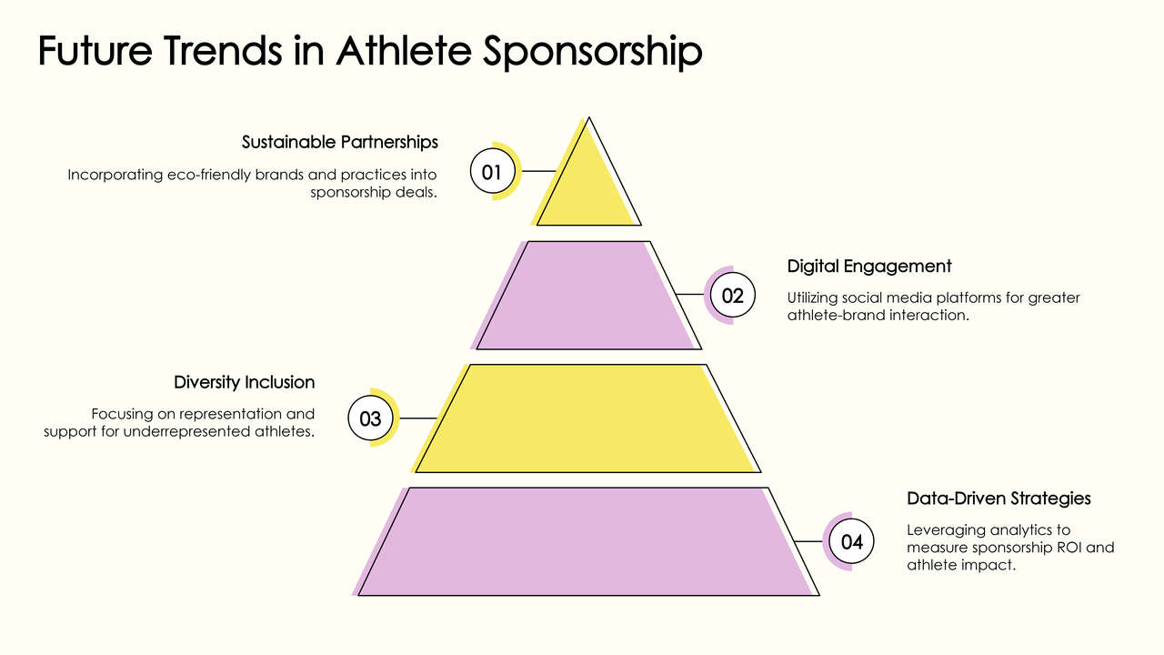

Slide 10
Thank you.
From team no:22

